Slide 1
Bank Marketing Data Set
S18-Introduction to Data Analysis

Slide 2
Presenter, Problem & initial strategy
Name of presenter: Robert Conacher
Description of the problem:
- Build multiple machine learning models for bank marketing data using Python.
- Dataset: https://archive.ics.uci.edu/ml/datasets/bank+marketing.
- The data is related with direct marketing campaigns of a Portuguese banking institution. The marketing campaigns were based on phone calls. Often, more than one contact to the same client was required, in order to access if the product (bank term deposit) would be ('yes') or not ('no') subscribed
- The classification goal is to predict if the client will subscribe (yes/no) a term deposit (variable y)(Binary Value: 0-’No’ & 1-’Yes’)
How you would apply data analytics to the problem:
- Data would be prepared, perform exploratory data analysis, build the model and review metrics of each model
What are the likely impacts of applying data analytics:
- To derive a model with a degree of accuracy to predict if the client will subscribe (yes/no) a term deposit (variable y)
- Determine how successful the campaign was and the success of potential future campaigns

Slide 3
Methodology
The methodology in tackling this problem:
- Load the data into Python
- Conduct exploratory data analysis
- look at distribution (graphs)
- statistics mean,sd, (histograms & tables)
- determine if data is missing (Determine how to treat missing data)
- patterns or relationships between data(graphs)

Slide 4
Methodology
Select Machine Learning Algorithm
The data is structured (Columns are named) this would fall under a Supervised Learning Problem
Since we are dealing with a binary response variable we could treat this problem as a regression model or as a classification model
Build First Model – Score Model
Build Secondary Model – Score Model

Slide 5
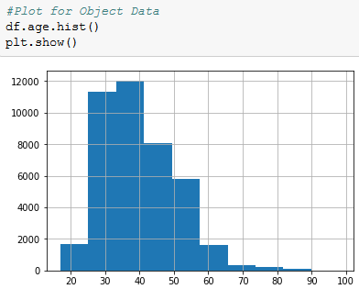
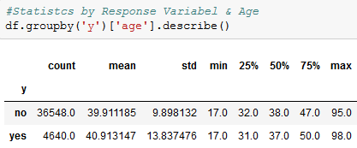
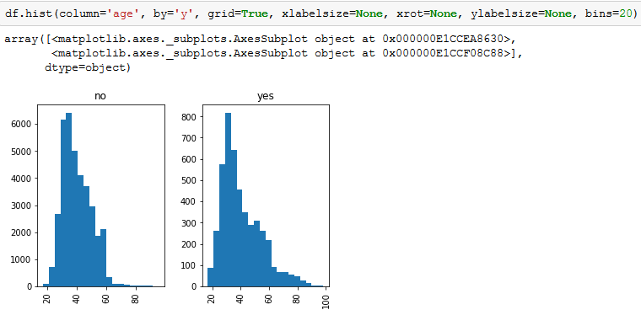
Data Analytics- Variable == Age
Top Left Data is skewed to the left with ages between 20 to 40’s with the long stretching tail to the right between 40 to 90s. Top Right Age data shows the average age is No=39.9 years & Yes=40.9. Both have significantly high standard deviations of (9.88 & 13.83). Bottom Left Data seems similar distributed based on the Yes & No but 89% of the data is under No with 11% under Yes.

Slide 6
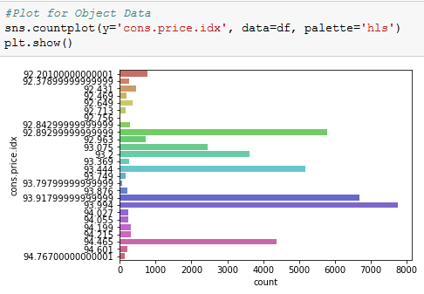
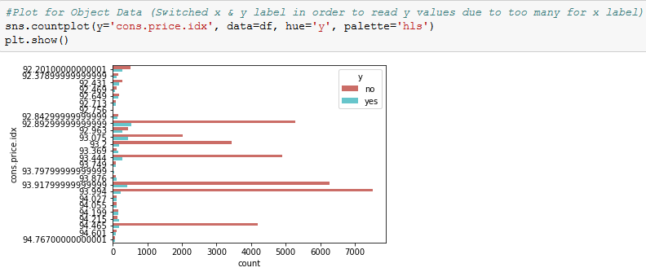
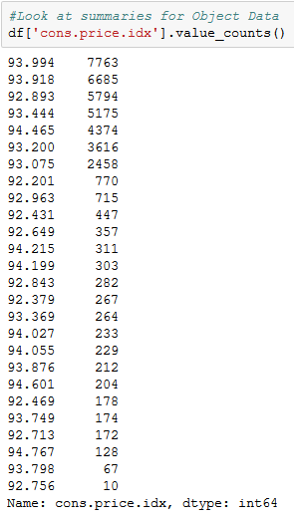
Data Analytics- variable == Consumer Price Index (CPI)
Top Left Graph show the distribution of Consumer Price Index. Top Right Graph show the distribution of Consumer Price Index. Showing split for each CPI by the response variable (Y/N) Bottom Right Shows the actual value / distribution for each CPI

Slide 7
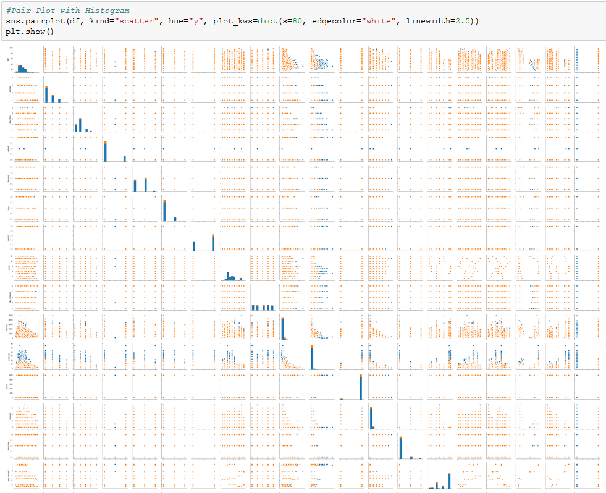
Data Analytics-Pair Plot with Histograms

Slide 8
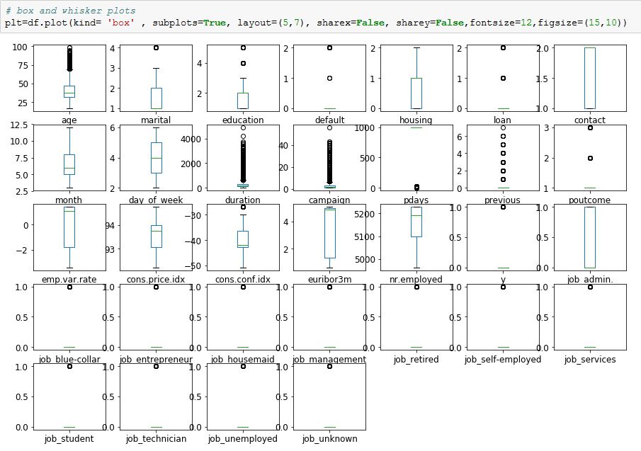
Data Analytics-Box & Whisker Plots

Slide 9
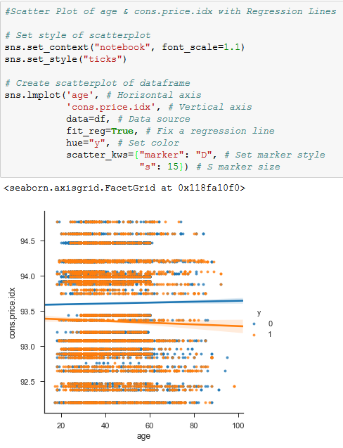
Data Analytics-Scatterplot

Slide 10
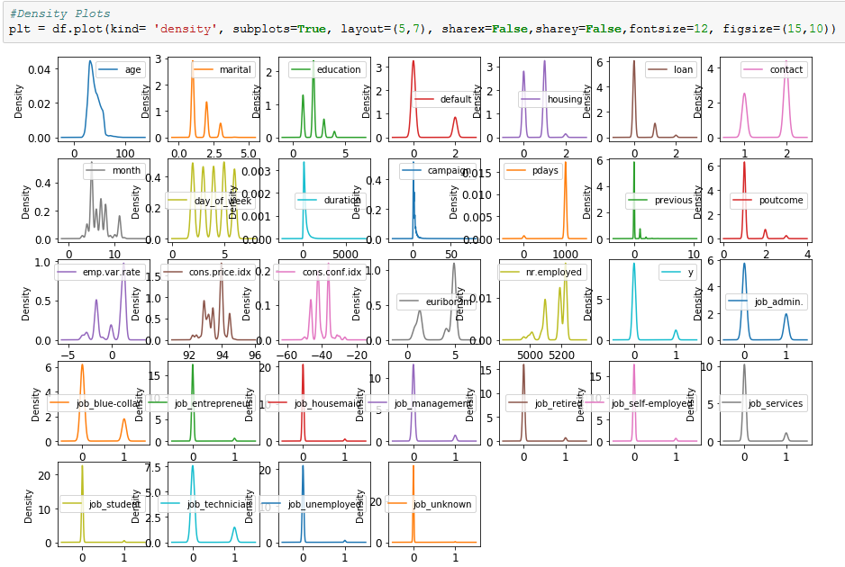
Data Analytics-Density plots

Slide 11
Initial Model
Describe your first choice for model building
- Support Vector Machine
Justify your choice. How is it meaningful or relevant for the business problem at hand?
Works for both Regression & Classification Problems
Works with Binary Response
Binary response is kept separated by the Maximum Margin Hyperplane
Works extremely well on both linear & non linear problems

Slide 12
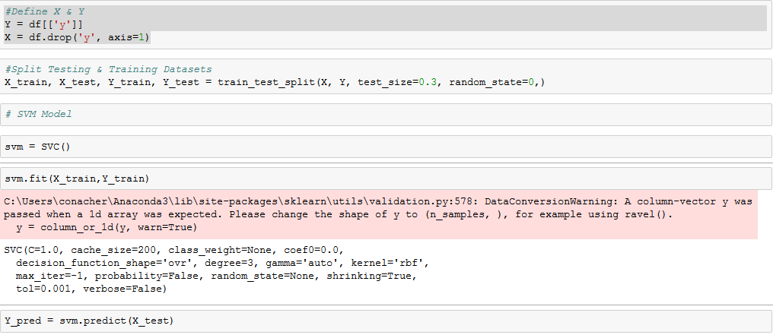
Initial Model
Describe your model

Slide 13

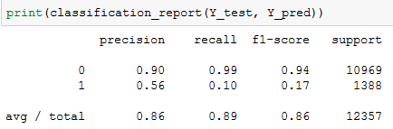
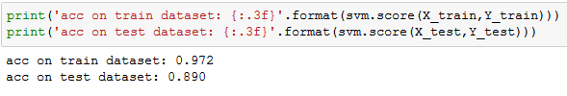

Initial Model
Report on performance metrics of your model: SVM
Model did a decent job for a first model. 86% Precision, 89% Recall, 86% F1 Score. Accuracy on both training (97.2%) & test (89.0%) are alright. AUC score seem low but we will have to see after second model. Concern is under confusion matrix (1244+115) seems high as miss classified also with the large unbalanced dataset “Yes or 1” Precision 56%, Recall 10% & F1 Score 17% is not that great.

Slide 14
Second model
Describe your first choice for model building
- Logistic Regression Model
Justify your choice. How is it meaningful or relevant for the business problem at hand?
Dependent Variable is “0” or “1”, only 2 responses (No/Yes, True/False or Alive/Dead)
Binary Response
Model very good at calculating or predicting thru regression
logistic regression predicts the probability of particular outcomes rather than the outcomes themselves

Slide 15
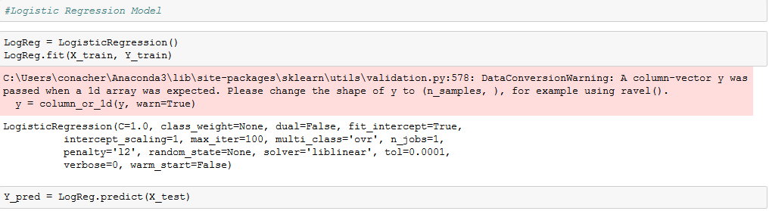
Second model
Describe your model

Slide 16

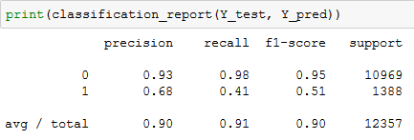


Second model
Report on performance metrics of your model: Logistic Regression
This model did a better job than the first model. Confusion Matrix miss classified is lower with (814+271). Precision, Recall & F1 Scores are better overall & both the Yes(1) & No(0). Better results on the test set than the training set. AUC Score is much better. Logistic Regression model overperformed the SVM model on almost every metric.

Slide 17
Recommendation & conclusions
Make a recommendation on which model should be selected among your: two models
Logistic Regression model (LR)
State your conclusion based on this data analytics exercise:
Logistic Regression out performed SVM in this dataset (AUC Score, Precision, Recall, F1)
AUC Score: 69.44 Logistic Regression vs 54.66 SVM
Both models performed on the No (Binary value=0) better than Yes. This was due to No having an extreme impact on the dataset (not balanced – No account for approx. 89% of the complete dataset)
LR – Test data out performed training data over all (91.2% vs 90.9%). SVM –Test data under performed training data ( 89.0% vs 97.2%)
LR- Overall Precision(90%), Overall Recall (91%), Overall F1 (90%): SVM-Overall Precision(86%), Overall Recall (89%), Overall F1 (86%)
LR- “0”Precision(93%), “0”Recall (98%), “0”F1 (95%): SVM-”0”Precision(90%), “0”Recall (99%), “0”F1 (94%) –- (No Responses)
LR- “1”Precision(68%), “1”Recall (41%), “1”F1 (51%): SVM-”1”Precision(56%), “1”Recall (10%), “1”F1 (17%) – (Yes Responses)
Only 2 models were selected. Too few for research of this size of dataset
Additional models, feature addition / reduction or hyperparamer tweaking would optimize the models effectiveness
Ensemble models with their resampling characteristics could increase the models effectiveness
Additional research to see if an “Incremental Response Model” for future research (May minimize a loss of existing customers and only targeting new customers that can be persuaded)
State what are the possible business outcome:
-By selecting only the most likely buyers, the proposed model creates value for the bank telemarketing managers in terms of campaign efficiency improvement (e.g., reducing client intrusiveness and contact costs). Thus maximizing a return on investment (ROI) for the bank.
- Targets telemarketing budget to be allocated in the most efficient & effective manner in order to grow business thru their products

